Slide 1

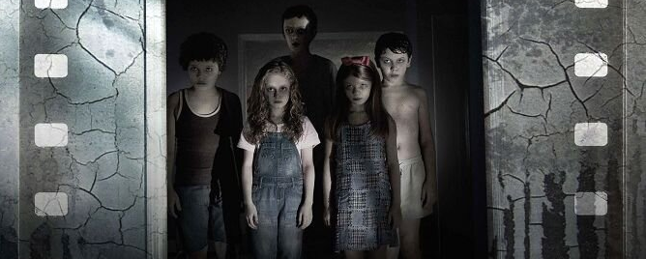
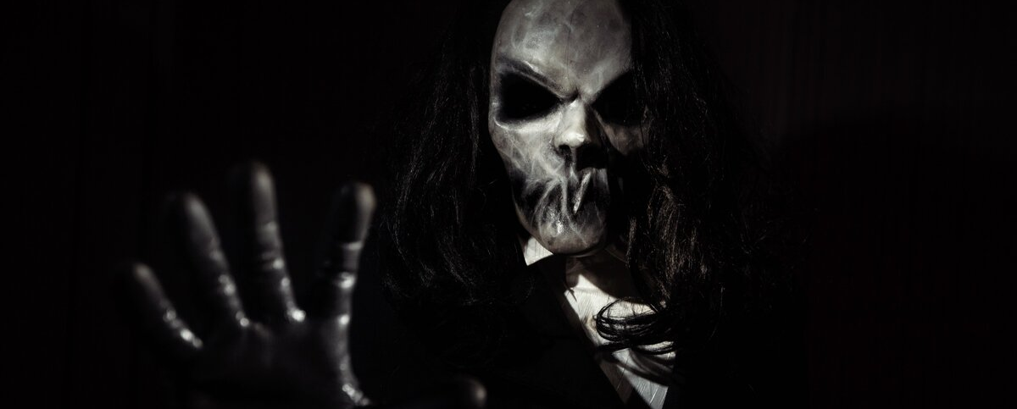

Sinister
Vaganova O.
Group № 3834101/30001

Slide 2
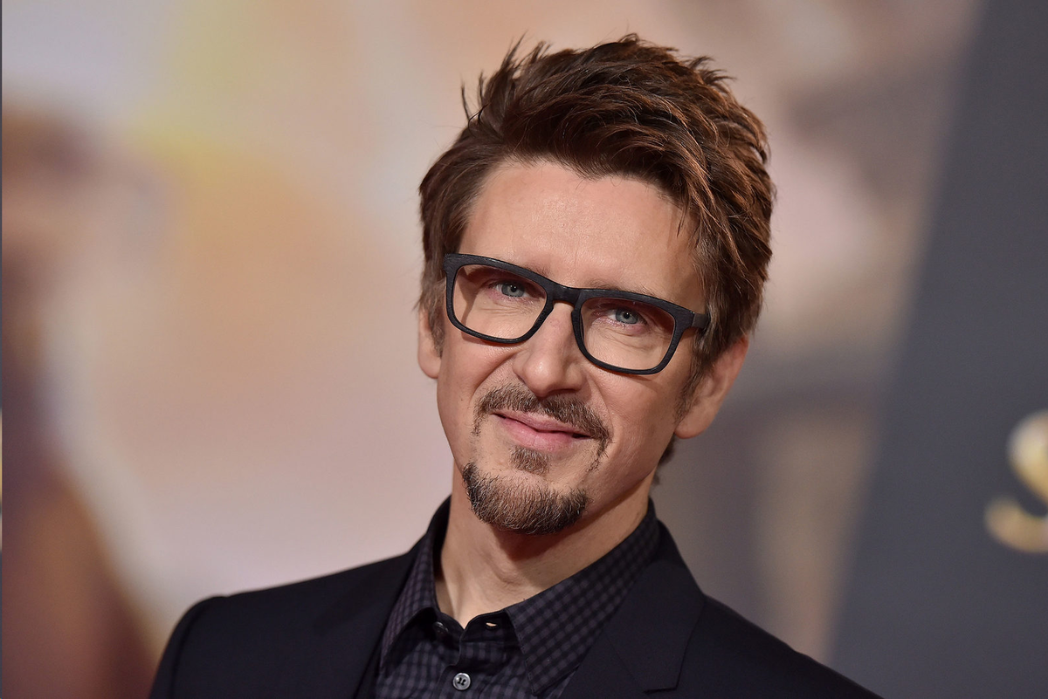
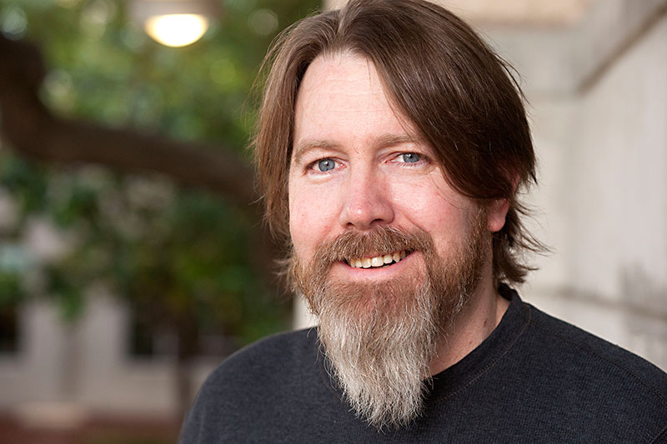
Sinister is a 2012 supernatural horror film
directed by Scott Derrickson
written by C. Robert Cargill

Slide 3
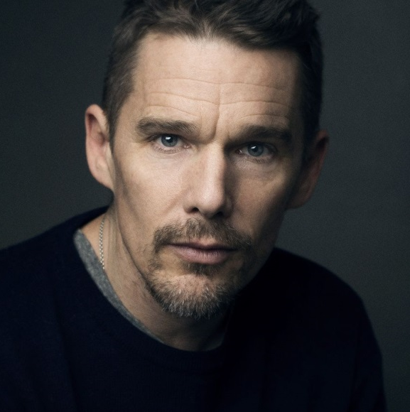
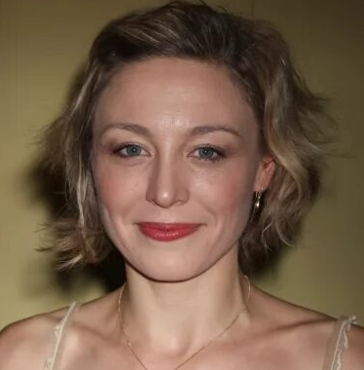
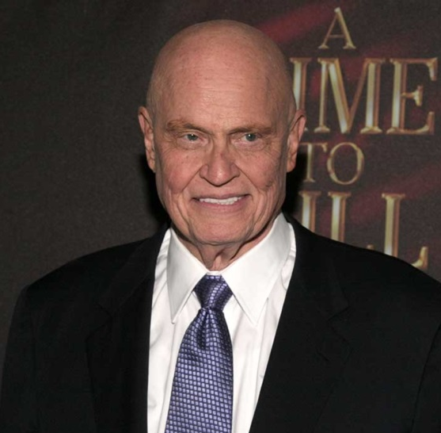
Sinister
Actors
The film was released on October 12, 2012 and premiered at the SXSW festival.
Ethan Hawke
Juliet Rylance
Fred Thompson
as Ellison Oswalt
as Tracy Oswalt
as Sheriff

Slide 4
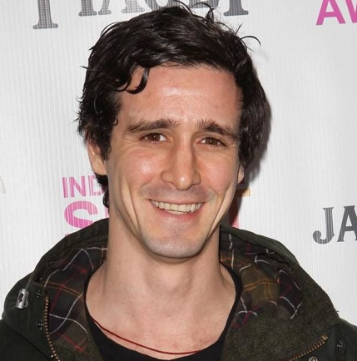
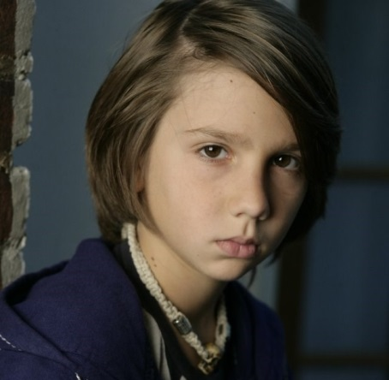
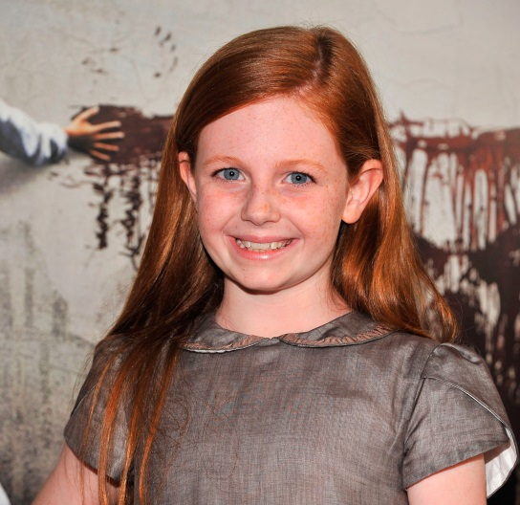
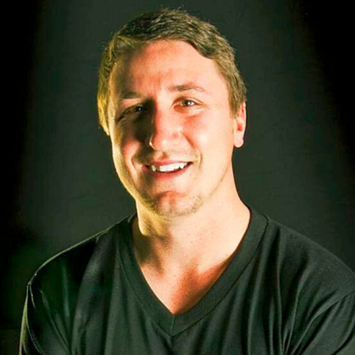
Sinister
Actors
Sinister was inspired Cargill by a nightmare Cargill had after watching the 2002 film The Ring
Clare Foley
Nick King
James Ransone
Michael Hall
D’Addario
as Deputy
as Ashley Oswalt
Portrays Bughuul/Mr. Boogie
as Trevor Oswalt

Slide 5
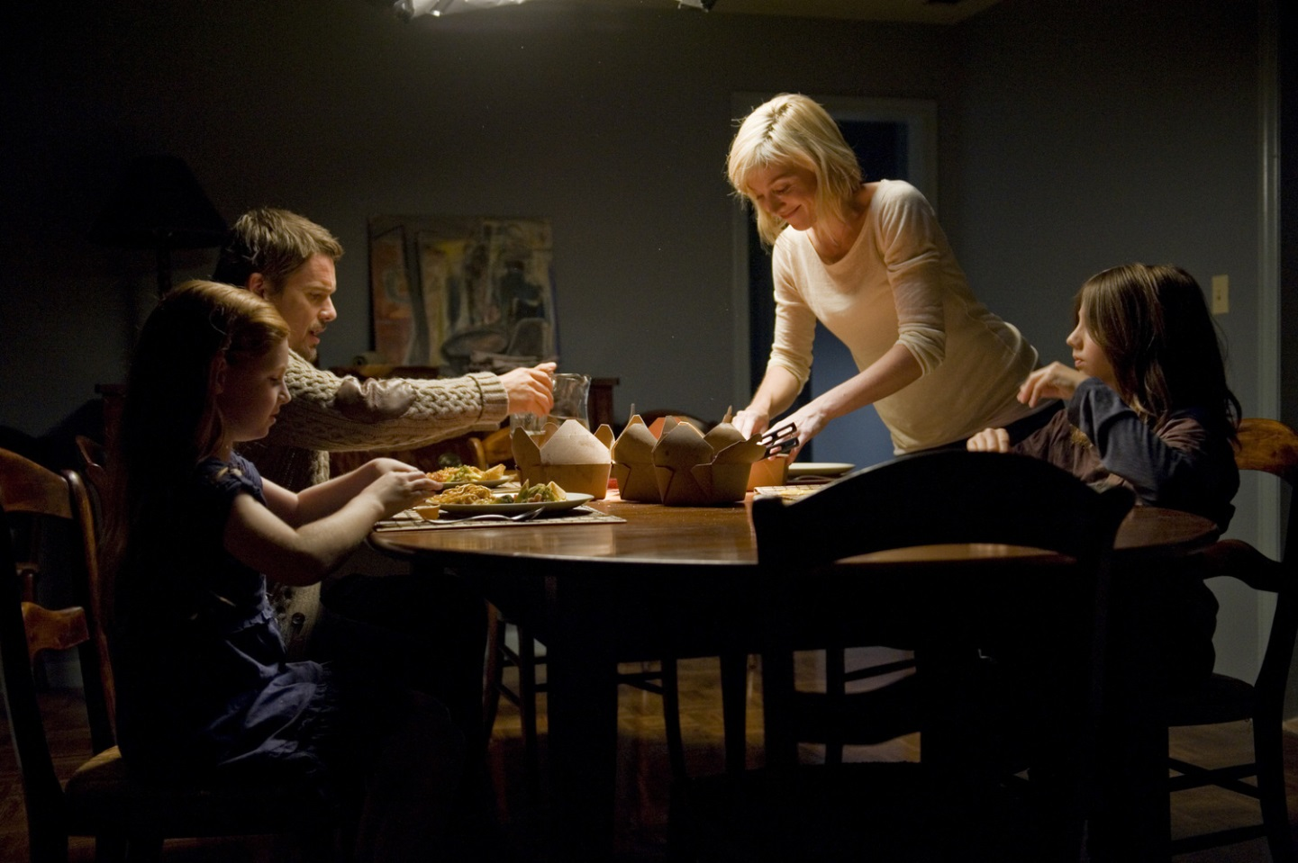
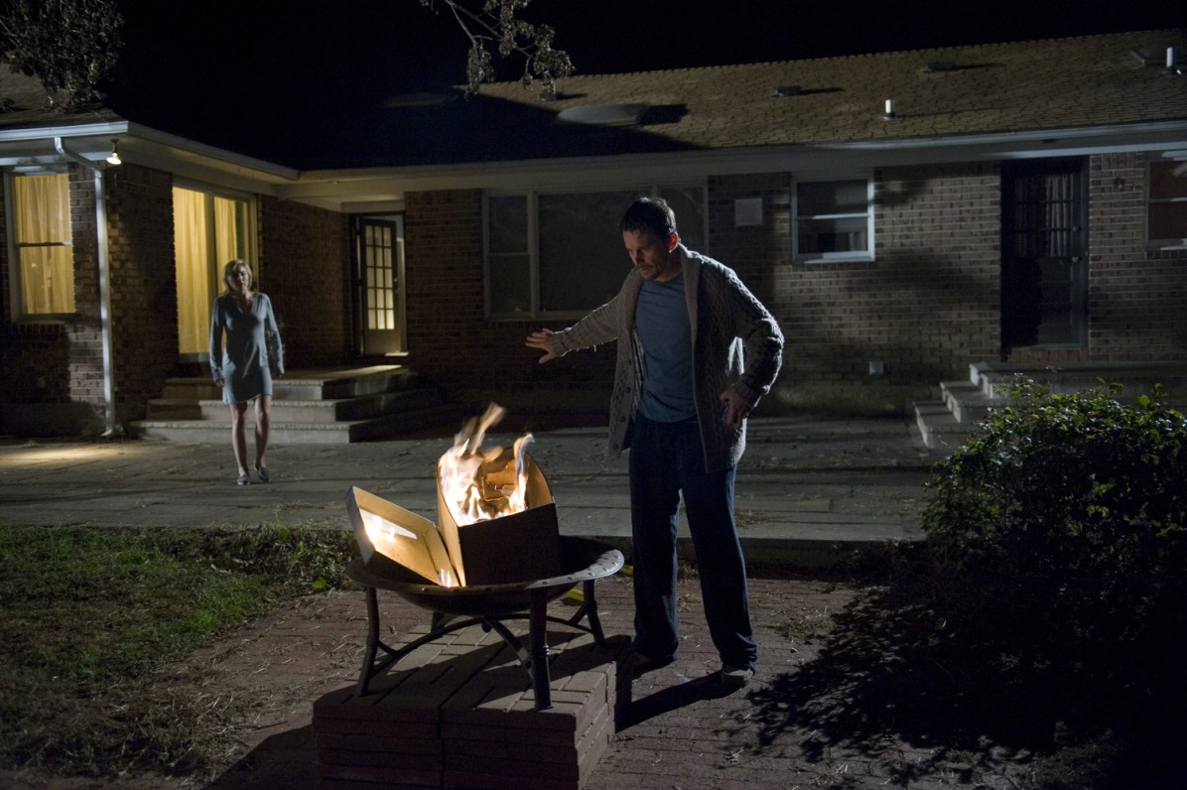
Ellison has moved family into a home where the Stevenson family were killed by hanging
Ellison decides to write about it as well as the disappearance of the family’s daughter Stevenson family were killed by hanging

Slide 6
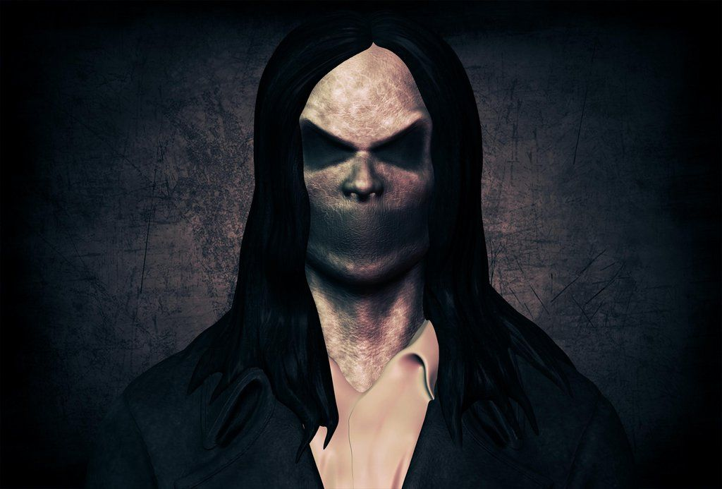
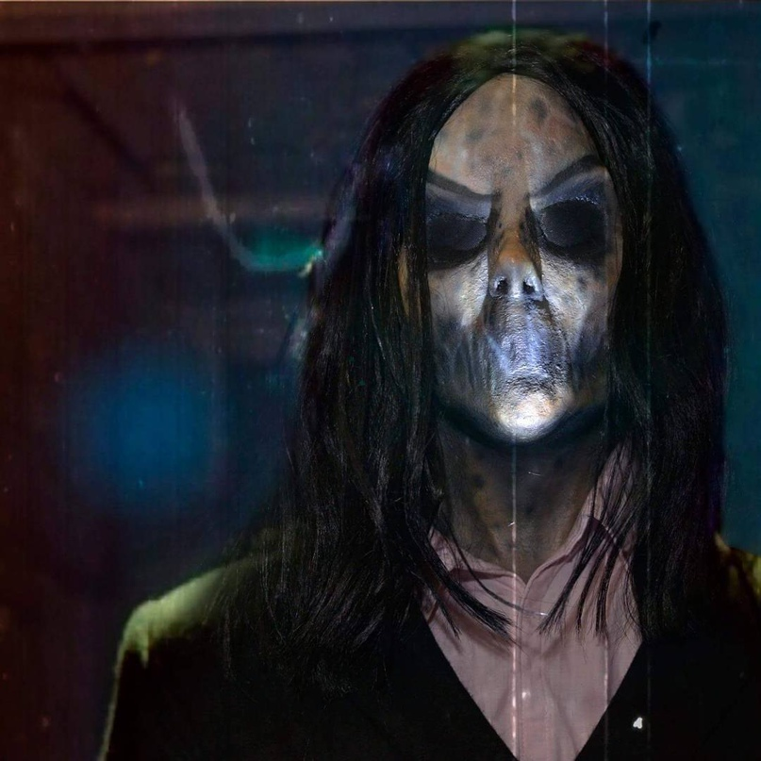

Bughuul or Mr Boogie
Clad in a suit, and with a head covered in long hair flowing down over hollow eyes and a mouthless face
Вставьте ваш текст
Instead, he lurks, waiting for
what only he knows.
Вставьте ваш текст

Slide 7
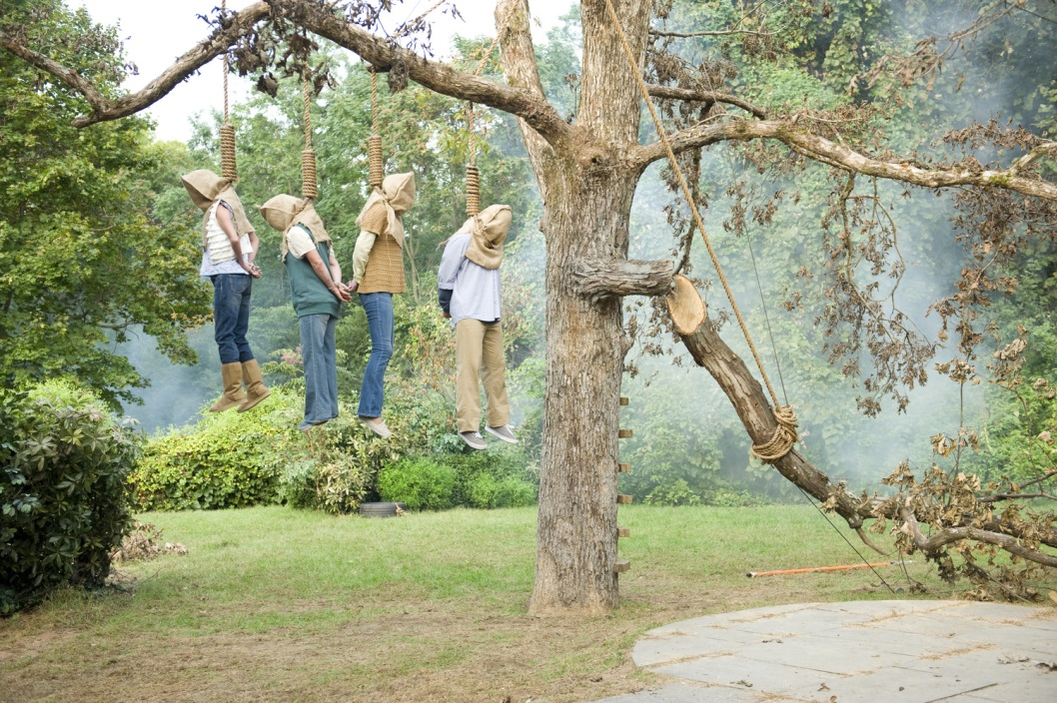
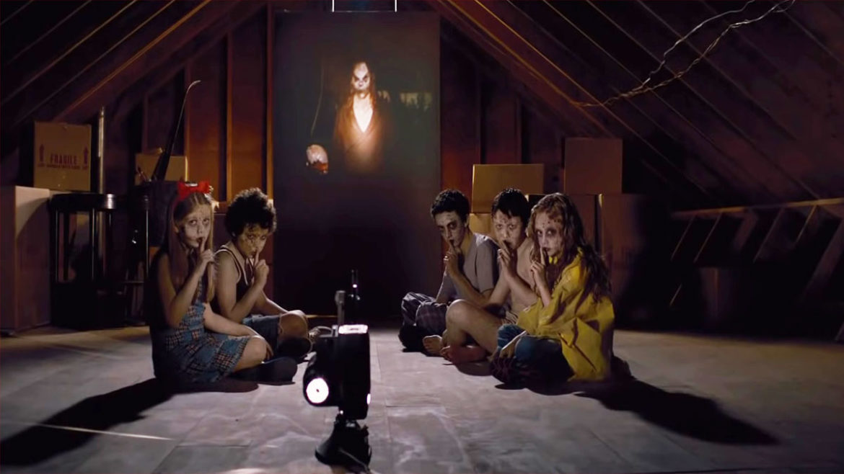
The Oswalt family is the next to die No one is saved!
There is no happy ending!

Slide 8
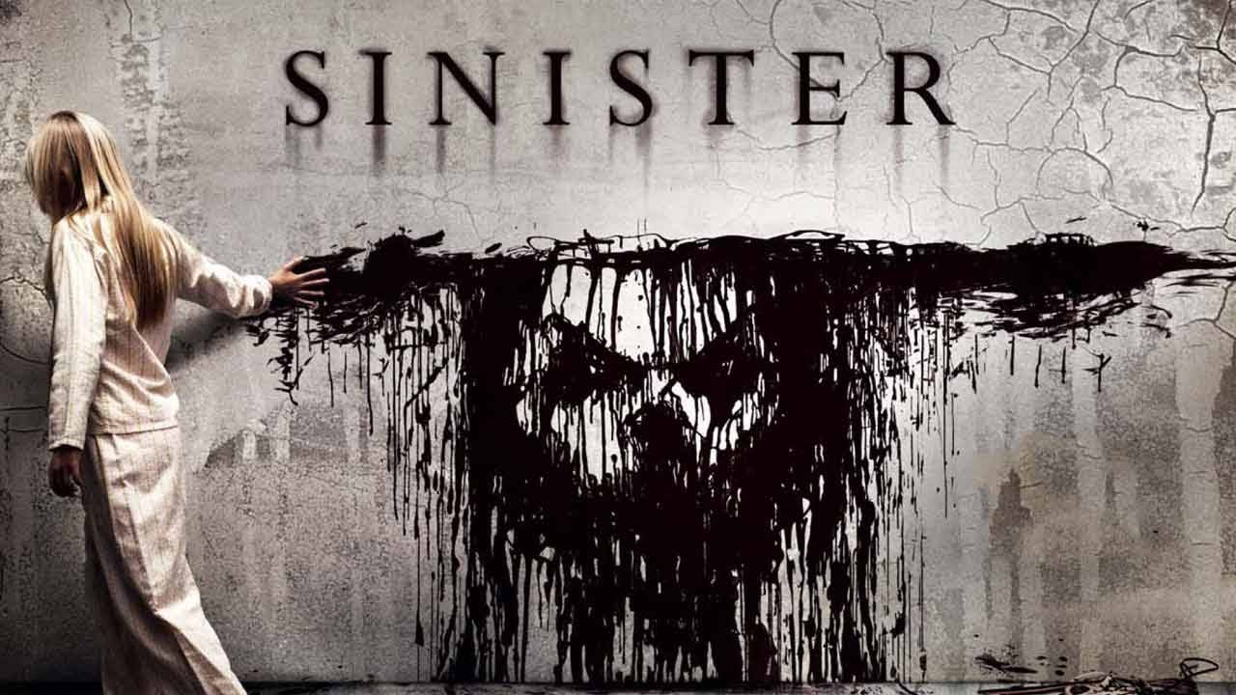
Sinister is the scariest film ever made

Slide 9
Thank You
for Your Attention!

